Slide 1

Chapter 5
TECHNIQUES OF INTEGRATION

Slide 2
Contents
5.1. The Infefine Integral
5.2 The Substitution Rule
5.3. Integration by Parts
5.4 Improper Integrals

Slide 3
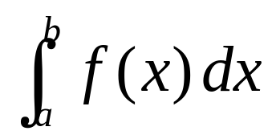
5.1. The Indefinite integral
Definition
Due to the relation given by the FTC between antiderivatives
and integrals, the notation ∫ f(x) dx is traditionally used for an
antiderivative of f and is called an indefinite integral.
Thus, ∫ f(x) dx = F(x) means F’(x) = f(x).
You should distinguish carefully between definite and indefinite integrals. A definite integral is a number.
An indefinite integral ∫f(x)dx is a function (or family of functions).
Notes:
The right-hand side is a function of x and not t.

Slide 4
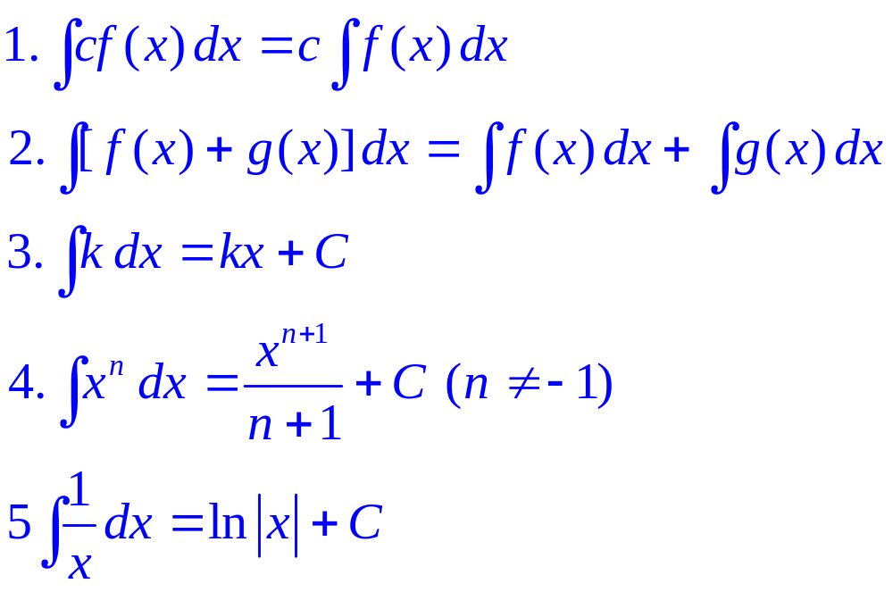
5.1. The Indefinite integral
Formular
Notes:
The right-hand side is a function of x and not t.

Slide 5
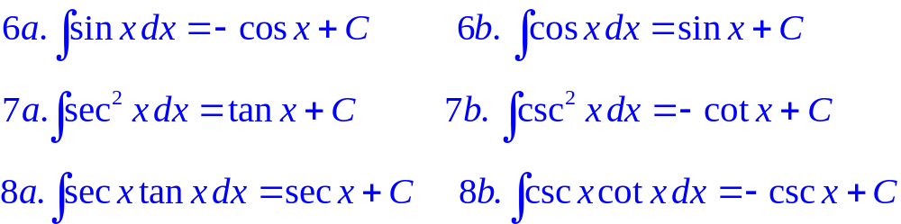
5.1. The Indefinite integral
Formular
Notes:
The right-hand side is a function of x and not t.

Slide 6
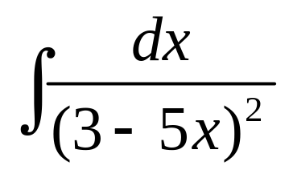
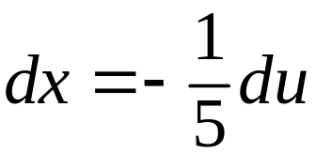


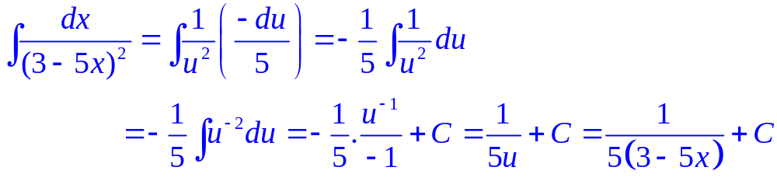
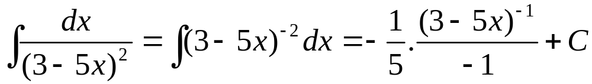
5.2. The Substitution Rule
Example: Evaluate
Solution:
Let .Then, , so
Method 2:

Slide 7
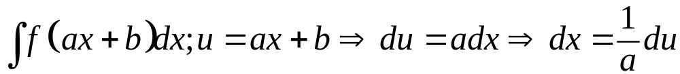
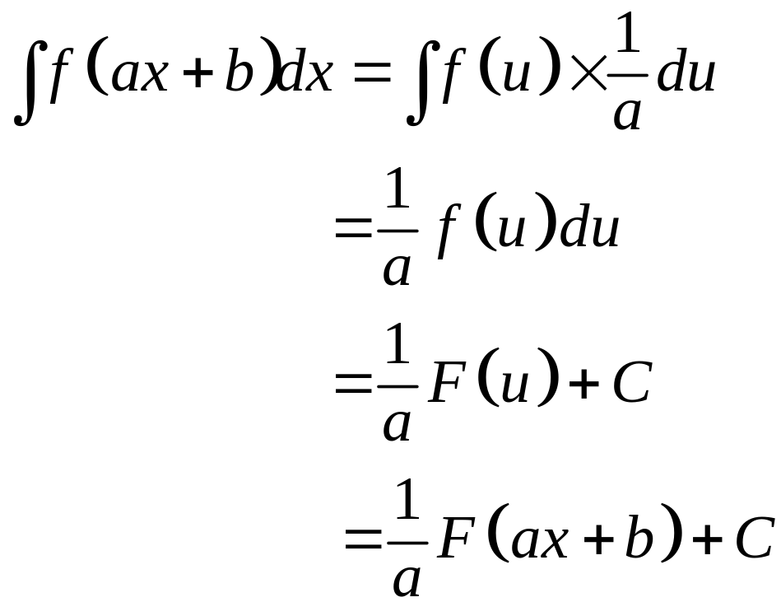
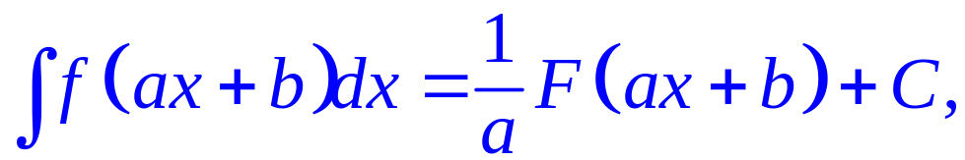
5.2. The Substitution Rule
General:

Slide 8
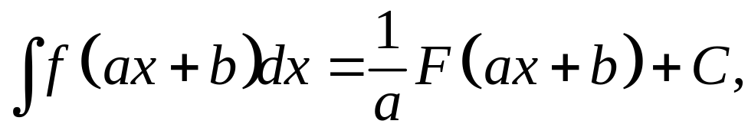
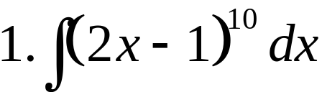
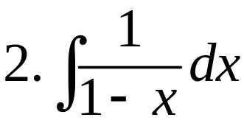
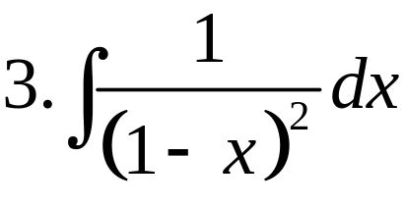
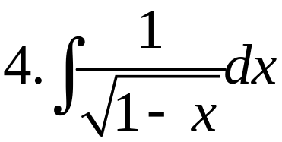
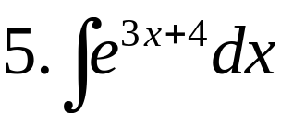
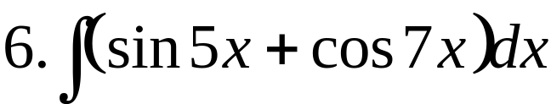
5.2. The Substitution Rule
Example: Use the formular find:

Slide 9
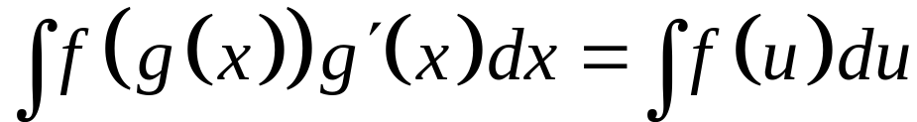
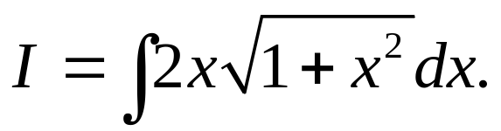
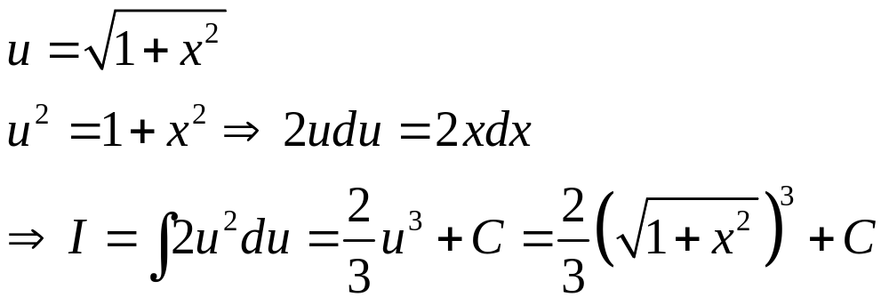
5.2. The Substitution Rule
Theorem
If u = g(x) is a differentiable function whose range is an interval I and f is continuous on I, then
Example 1: Evaluate
Solution:

Slide 10
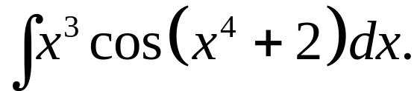
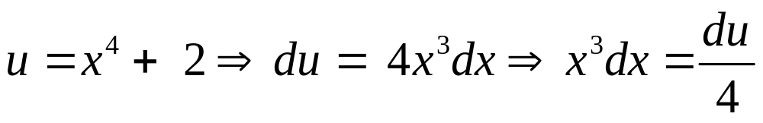
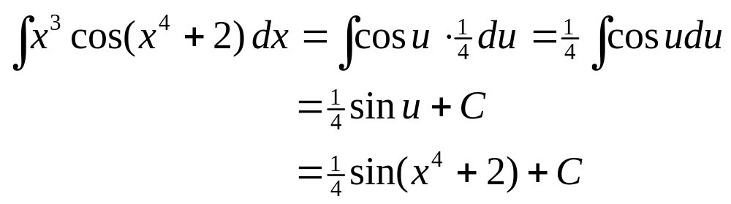
5.2. The Substitution Rule
Example 2: Evaluate
Solution:

Slide 11
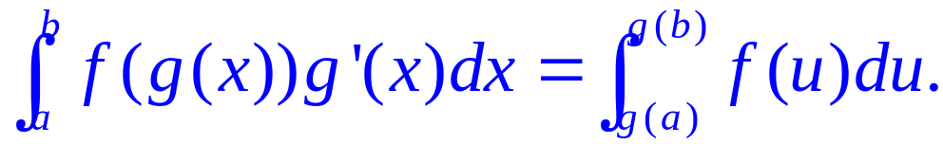
5.2. The Substitution Rule
Sub.rule for def. integrals:
If g’ is continuous on [a, b] and f is continuous on the range
of u = g(x), then
Let F be an antiderivative of f. Then, F(g(x)) is an antiderivative of f(g(x))g’(x).
So,

Slide 12
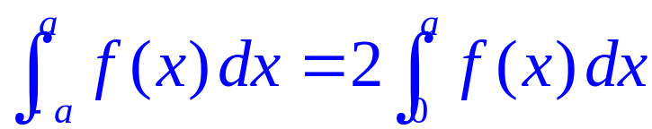
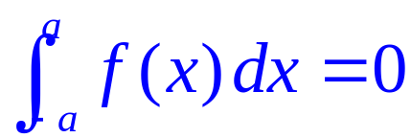
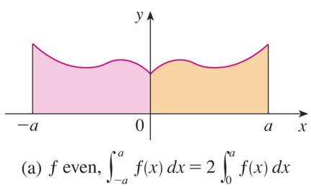
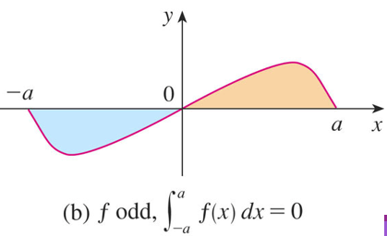
5.2. The Substitution Rule
Integs.of symm.functions:
Suppose f is continuous on [–a , a].
a/ If f is even, [f(–x) = f(x)], then
b/ If f is odd, [f(-x) = -f(x)], then

Slide 13
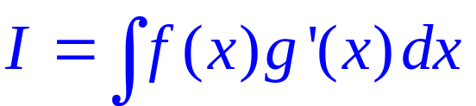
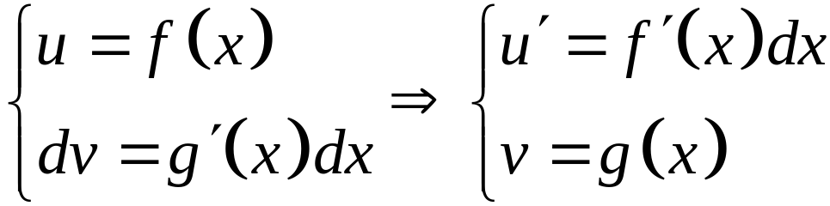
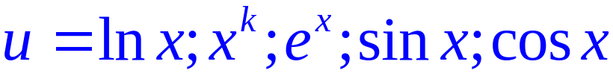
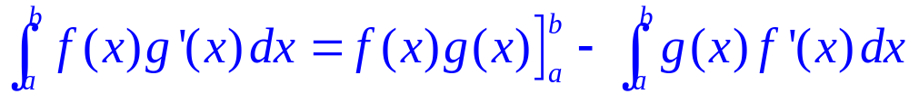
5.3. Integration by parts
Formula
Set
Thus, by the Substitution Rule, the formula for integration by parts becomes:
Note:
Using the FTC, we obtain:
Notes:
Let u = ?; dv = ?
How to choose u and dv to make the resulting integral simpler.
The analogy with u-substitution: u-substitution is “undoing” the Chain Rule, and integration by parts is “undoing” the Product Rule.

Slide 14
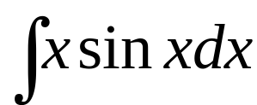
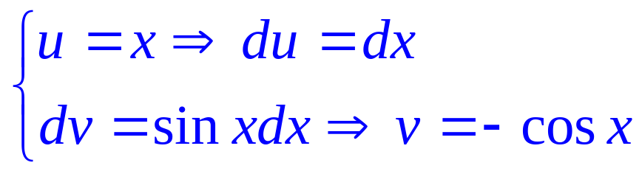
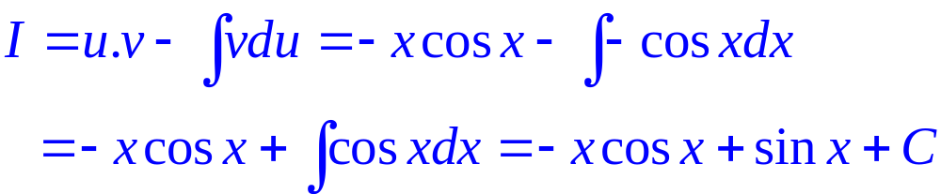
5.3. Integration by parts
Example 1: Find
Solution:

Slide 15
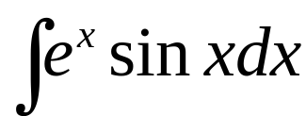
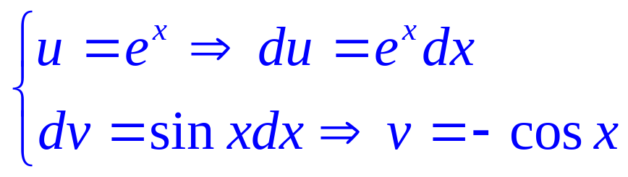
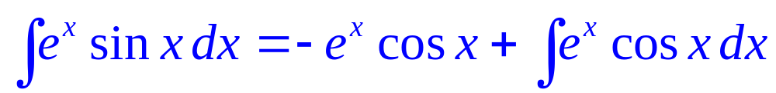
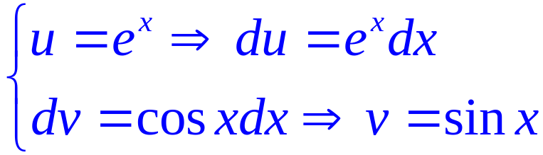
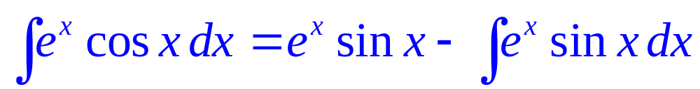
5.3. Integration by parts
Example 2: Find
Solution:
  Step 1: Set
  Step 2: Set

Slide 16
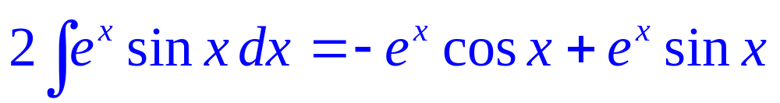
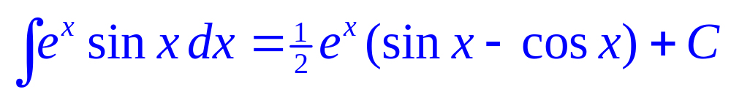
5.3. Integration by parts
  Step 3: This can be regarded as an equation to be solved for the unknown integral.
  Adding to both sides ∫ e^{x} sin x dx, we obtain:
  Dividing by 2 and adding the constant of integration, we get:

Slide 17
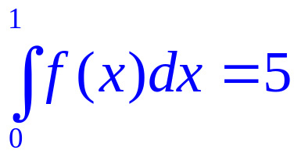
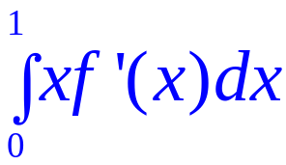
5.3. Integration by parts
Example 3: Suppose f(x) is continuous and differentiable, f(1)=4 and . Find
a | 4/5
b | 5/4
c | 1
d | None of the others
e | -1

Slide 18
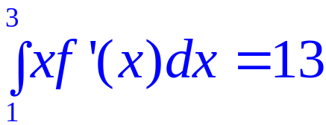
5.3. Integration by parts
Example 4: Suppose f(x) is continuous and differentiable, f(1)=3, f(3)=1 and What is the average value of f on the interval [1,3] ?

Slide 19
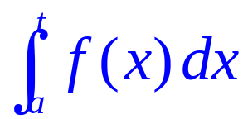
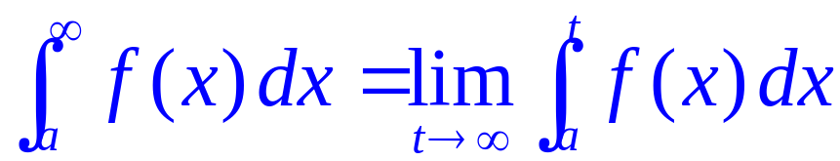
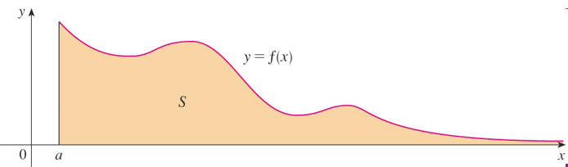
5.4. Improper Integrals
Improper Integrals of type 1
Definition: If exists for every number t ≥ a, then
provided this limit exists
(as a finite number).

Slide 20
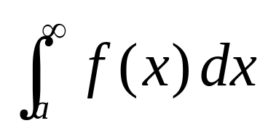
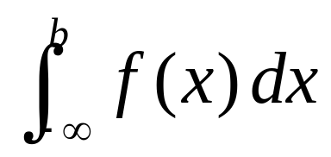
5.4. Improper Integrals
Improper Integrals of type 1
Convergent and divergent:
The improper integrals and
are called:
  Convergent if the corresponding limit exists.
  Divergent if the limit does not exist.

Slide 21



5.4. Improper Integrals
If both and are convergent, then
we define:
  Here, any real number a can be used.

Slide 22



5.4. Improper Integrals
Example 1: Evaluate:
a/
b/
c/

Slide 23



5.4. Improper Integrals
Solution:
a/
Step 1:
Step 2:

Slide 24



5.4. Improper Integrals
Solution:
b/
Step 1:
Step 2:

Slide 25



5.4. Improper Integrals
Solution:
c/
Step 1:
Step 2:

Slide 26



5.4. Improper Integrals
Example 2: Evaluate:
a/
b/
c/

Slide 27



5.4. Improper Integrals
Solution:
a/
Step 1:
Step 2:

Slide 28



5.4. Improper Integrals
Solution:
b/
Step 1:
Step 2:

Slide 29




5.4. Improper Integrals
Solution:
c/
Step 1:

Slide 30


5.4. Improper Integrals
Step 2:
So,

Slide 31


5.4. Improper Integrals
Improper Integrals of type 2
Definition 1a: If f is continuous on [a, b) and is discontinuous
at b, then
this limit exists (as a finite number).

Slide 32


5.4. Improper Integrals
Improper Integrals of type 2
Definition 1b: If f is continuous on (a, b] and is discontinuous
at b, then
this limit exists (as a finite number).

Slide 33

5.4. Improper Integrals
Improper Integrals of type 2
The improper integral is called:
  Convergent if the corresponding limit exists.
  Divergent if the limit does not exist.

Slide 34




5.4. Improper Integrals
Improper Integrals of type 2
If f has a discontinuity at c, where a < c < b, and
both and are convergent, then we
define:

Slide 35


5.4. Improper Integrals
Example: Evaluate:
a/
b/

Slide 36



5.4. Improper Integrals
Solution:
a/
Step 1:

Slide 37




Comparison theorem
5.4. Improper Integrals
Suppose f and g are continuous functions with f(x) ≥ g(x) ≥ 0 for x ≥ a.
a/ If is convergent, then is convergent.
b/ If is divergent, then is divergent.
Notes:
For example…

Slide 38



5.4. Improper Integrals
Theorem:
is: is:
  Convergent if p > 1 Convergent if p <1.
  Divergent if p ≤ 1 Divergent if p 1

Slide 39




5.4. Improper Integrals
Example:
Use the Comparison Theorem to determine whether the integral is convergent or divergent.
a/ b/
c/ d/

Slide 40







5.4. Improper Integrals
Solution:
a/
is just an ordinary definite integral.
we have so
Therefore

Slide 41

5.4. Improper Integrals
Solution:
a/ we see that is convergent.
In the Comparison Theorem, It follows that is
convergent.

Slide 42





5.4. Improper Integrals
Solution:
b/
We have
is divergent
The integral is divergent by the Comparison
Theorem.

Slide 43




5.4. Improper Integrals
Solution:
c/
We have
is divergent
The integral is divergent by the Comparison
Theorem.

Slide 44



5.4. Improper Integrals
Solution:
d/
We have
is convergent
The integral is convergent by the Comparison
Theorem.

